Slide 1
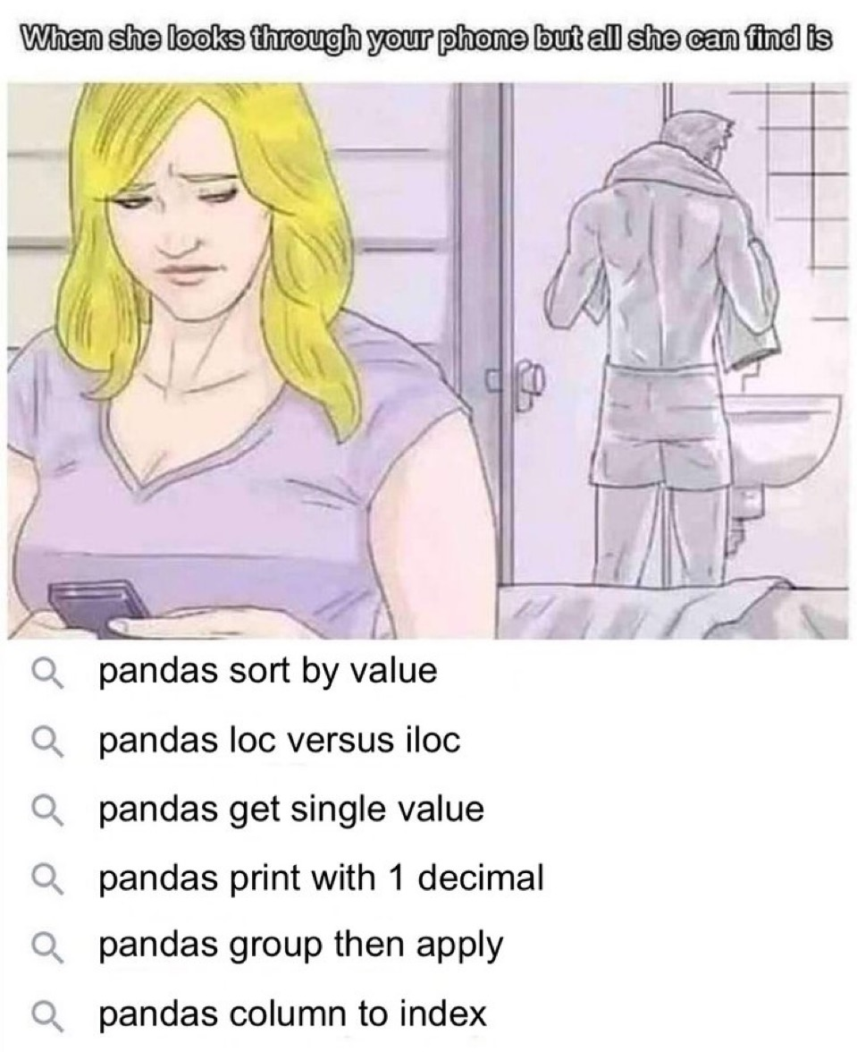
Topic 3 – Exploratory Data Analysis
Data Science for Business
Prof: Chris Volinsky
NYU Stern: Fall 2024

Slide 2
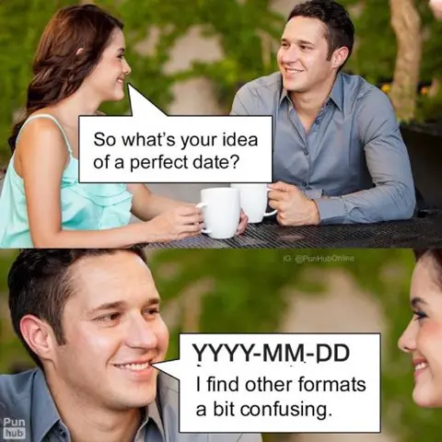

Slide 3
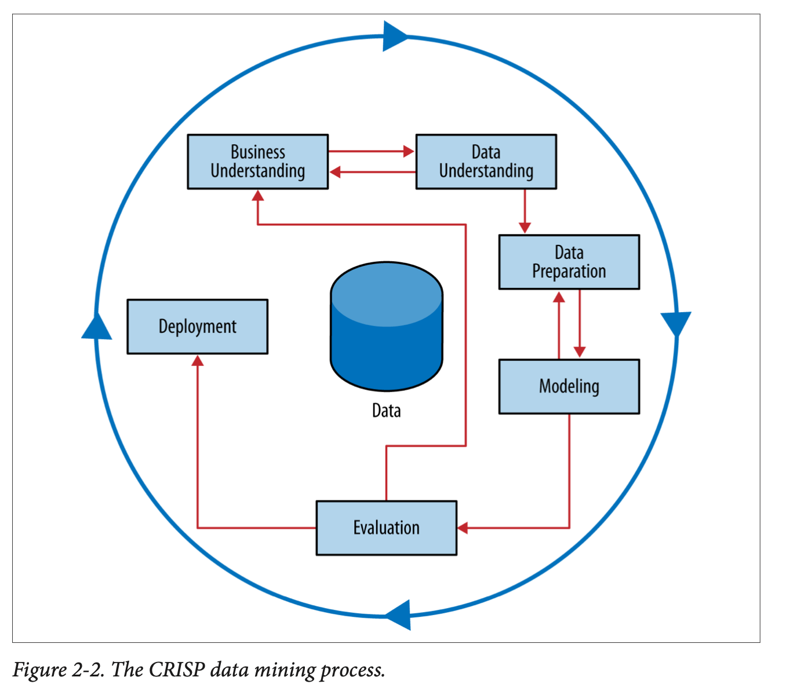
Understanding Your Data
Understanding your data goes hand and hand with the business problem you are trying to solve

Slide 4
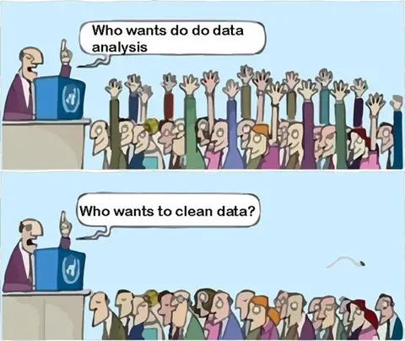
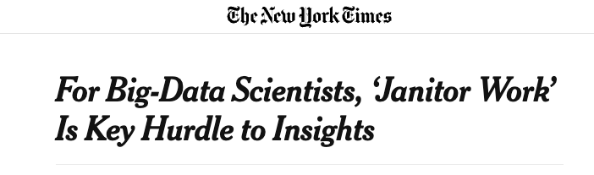
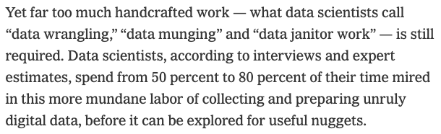
Reality
Steve Lohr NYT 8/17/2014
Notes:
AI has promise but does not necessarily make this better!!

Slide 5
Managing Data
T3_Managing_Data.ipynb

Slide 6
Where to Find Data
In business critical systems
Challenge: these systems are often not set up for collection of data, they are for running a business. Much cleaning needed.
Online
Challenge: Companies often do not give access to critical data, and if they do it is via a rate limited API
Can use parsers, scrapers, and other tools
Useful modules like Beautiful Soup* can scrape web sites
Using GenAI to get data (e.g. financial reports)
Curated data science websites
Challenges: Sanitized, much analyzed data
UCI repository
Lots of data science courses!
*https://pypi.org/project/beautifulsoup4/
Notes:
Talk here about finding data for their projects….dont try and take the easy road.

Slide 7
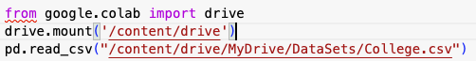
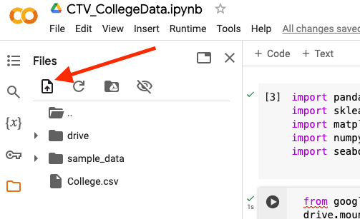
Reading in data to Python
Ideally data we will access will come to us in a nice Excel or CSV format.
This is not always true in real life – database access, SQL, streaming data are topics for another course (although ask if you need help!)
Reading in data via CSV requires the pandas module and the read.csv function
Several ways to do this:
Mount your Google Drive and read from there
Upload file from computer to Colab session
See “T1_UseGenAI.ipynb”
Read directly from a URL containing the data
college_df = pd.read_csv("https://www.statlearning.com/s/College.csv")
In some cases may need to read in data from SQL or JSON scripts
Come see me if you need help with this
Notes:
We are not covering json or sql in class.

Slide 8
Extracting Data from Websites
T3_Getting_Data_Through_APIs.ipynb

Slide 9
Exploring data
Important to take time to explore every feature of your data
Exploratory Data analysis – prior to any modelling – use tables and visualization:
Study (and understand) every feature!!
Know your feature types and distributions
Outliers
Missing Data
Duplicates and data inconsistencies
Consider Transformations
Explore multicorrelation

Slide 10
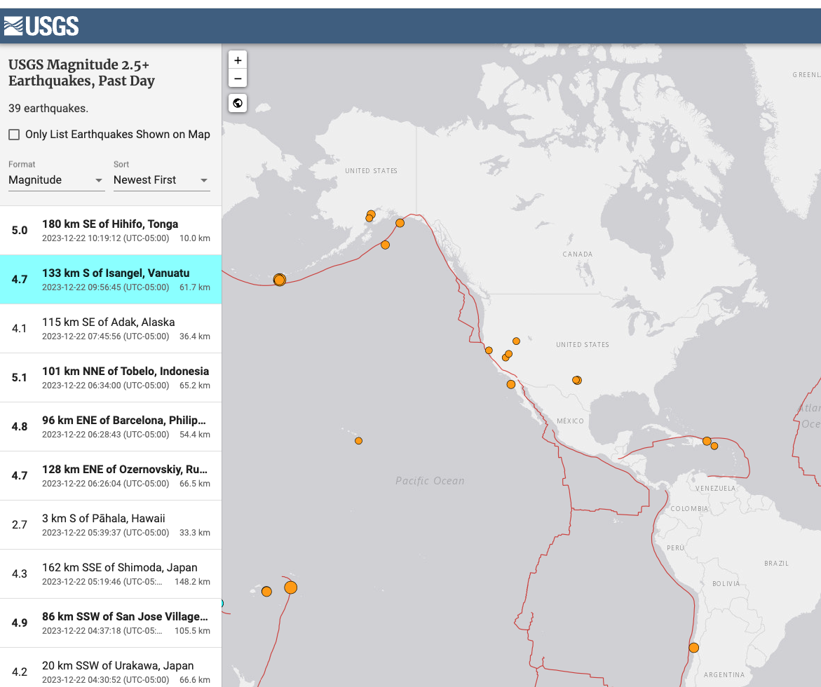
Types of Data
Structured
Unstructured
Time Series
Text
Image
Media (Audio/Video)
Spatiotemporal
Network-based
All of the above?

Slide 11
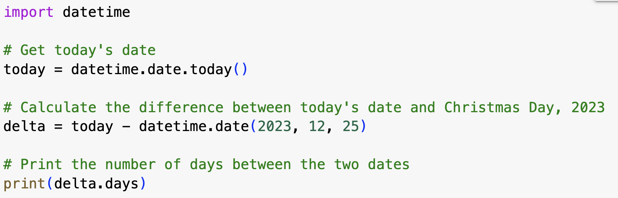
Feature Types
Numeric: anything where calculations are meaningful
Does addition / subtraction make sense
Categorical: cannot do meaningful calculations
Multi-valued
Might have numeric labels!
Are your categories ordered?
Ordinal: Income (A: 0-50k; B: 50k-100k; C: 100k-500k; D: > 500k)
Nominal: EyeColor (A:Blue; B=Brown; C=Green; D=Other)
Binary (special case of categorical):
Two possible values, in particular 0/1
Datestamps
Beware of format!
Can be considered numeric if treated carefully (Use import datetime )
Notes:
May need to create variables
Income – adding 10k makes sense, doubling makes sense
Test grade? : SAT – adding numbers makes sense, I guess.
e.g., average balance may not be in any database, but would have to be computed during the data prep stage.
What happens if you add “unknown” to an ordinal?

Slide 12
Things can get messy
How About
Names
Social Security numbers
Credit ratings
Zip codes
Text
Images, sound
SIC industry codes
You need to make sure that your software recognizes the right data type:
Make numbers look like numbers
Make categorical NOT look like numbers

Slide 13
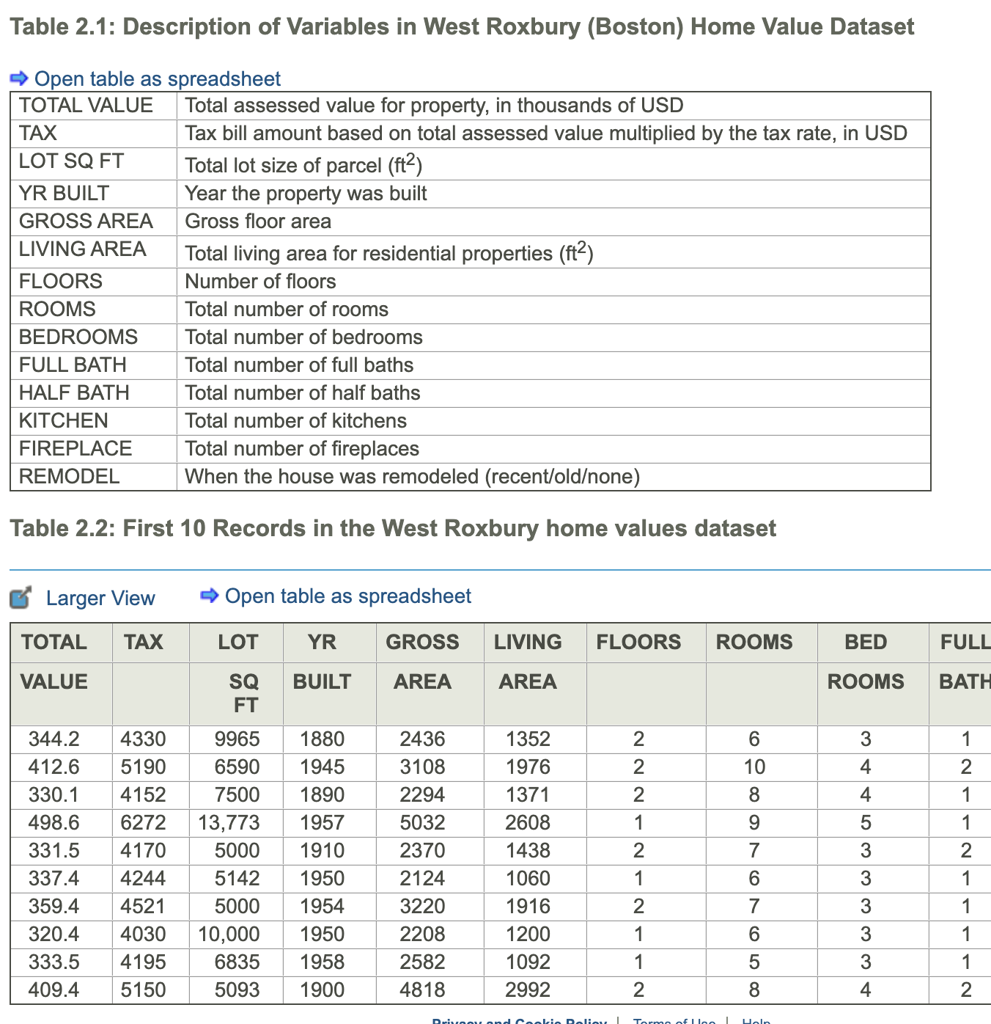
Exploring data in python
Example: Home prices in Boston
Looking at data in Python:
Ideally data can be input as a .csv file
Make sure no commas!
Python tools for initial manipulation of data
Renaming variables (.rename)
Summaries of variables (.info and .describe)
Exploring data (.head, .tail)
Viewing slices of data (.loc and .iloc)
Categorical variables (.value_counts)
Merging and splitting attributes (.concat, .split, other text tools)
Can use sampling if data is too large (.sample)
Play around with it!
Shmueli Ch2.4

Slide 14
Categorical Variables
Lets say we wanted to study impact of diet type on Cholesterol
Name | Diet | Cholesterol
Alberto | Vegetarian | 135
Becky | Vegan | 112
Callie | Omnivore | 198
Daneyah | Pescatarian | 201
Erica | Omnivore | 155
… | … | …
Four types:
Vegan (Vn)
Vegetarian (Vg)
Pescatarian (P)
Omnivore (O)
You can re-code this variable as k binary (0,1) indicator variables (also called dummy variables or one-hot encoding).
Note: only (k-1) dummies are needed to encode the information
For some methods (regression!) you must encode with (k-1) dummies to avoid an error
pandas.get_dummies (drop_first=TRUE) sklearn.preprocessing.OneHotEncoder (drop=‘first’)
Notes:
Note: This changes how you interpret the coefficients…
Redundant features may lead to

Slide 15
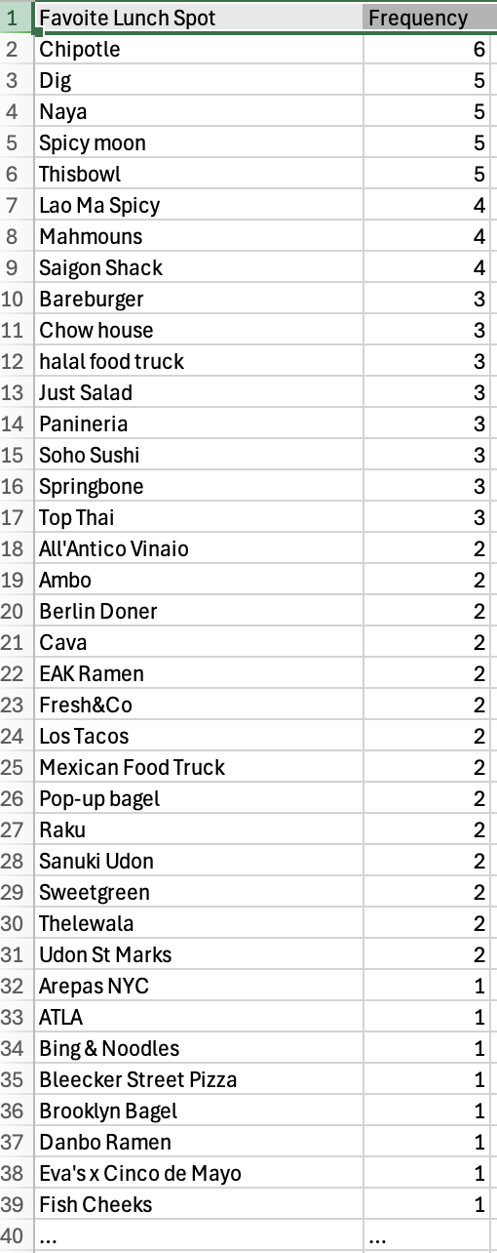
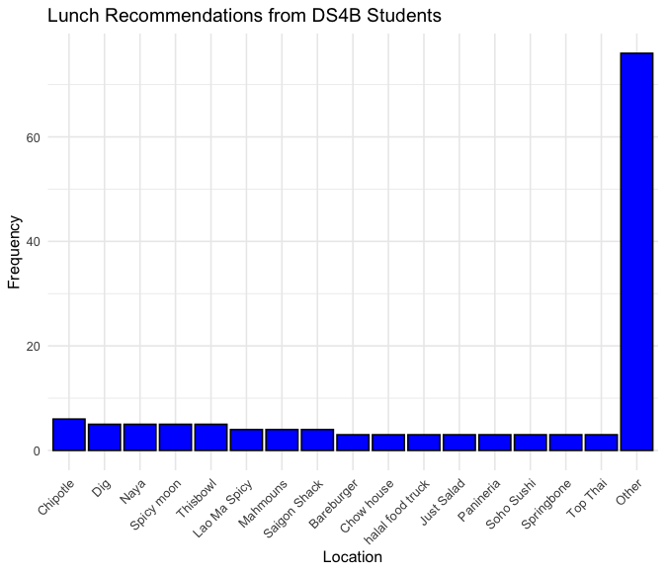
Categorical Variables
Another issue with categorical variables: there can be too many levels – this can make the model complicated and messy.
May want to transform to top levels + “other”
+ 40 more
Notes:
For interpreteability

Slide 16
Outliers
Outliers are observations that are far from the mean, and fall outside the range of most of the data
Can be found via summary tables, visualization or simple sorting
Look at each feature!!
Outliers typically are attributable to one of the following causes
The measurement is observed, recorded, or entered into the computer incorrectly. (Blood pressure = -50)
The measurement comes from a different population. (Age = 5)
The measurement is correct but represents a rare (chance) event. (Net worth = $3B)
Outliers should always be considered and inspected to see if they are “real” or some artifact of data collection
Notes:
Ask : how do you find outliers?
Blood pressure = -100
Temperature = 800
Net worth = 3B.
Go back to HBO example…hours…is there a smooth distribution with some high, or a spike or single value?
Even if real, you may want to delete it – to avoid overweight influence.

Slide 17
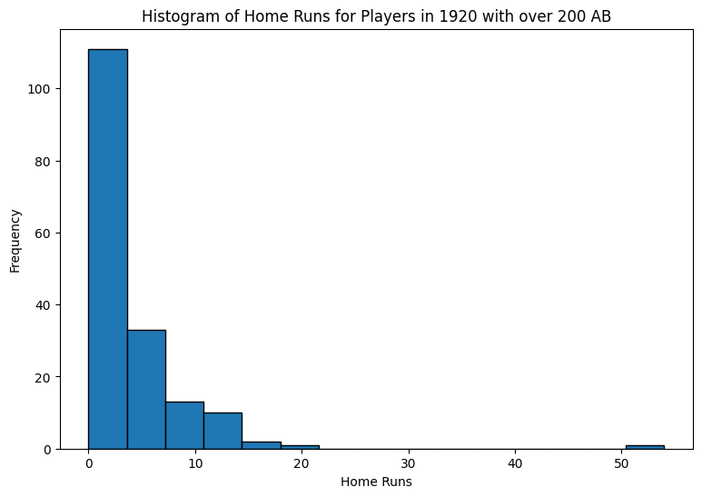
Outliers: Remove or no?
Outliers can have an outsize impact on analysis
You may choose to remove an outlier, even if it is legitimate, just to avoid influence on analysis
Or, choose a robust analysis technique
Regression is sensitive to outliers
Decision Trees much less so
Carefully assess data for legitimacy. If appears incorrect, remove it.
Blood Pressure = -50
Temperature = 180 degrees
Net worth = $3B
Do NOT blindly use automated outlier-finding algorithms
e.g IQR rule
Notes:
Q1 – 1.5 IQR…

Slide 18
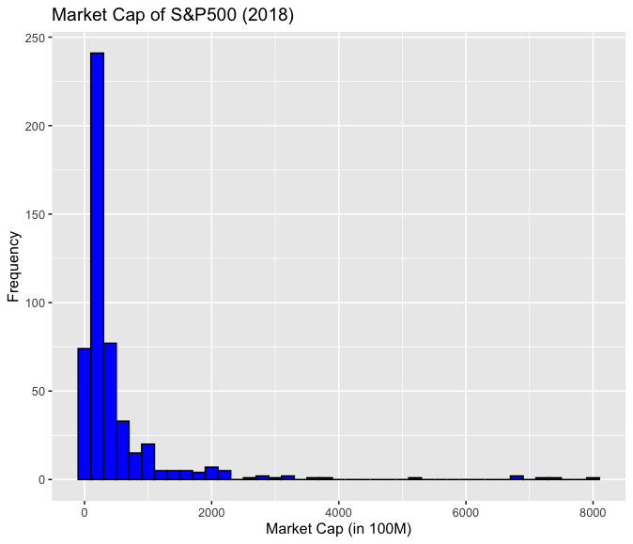
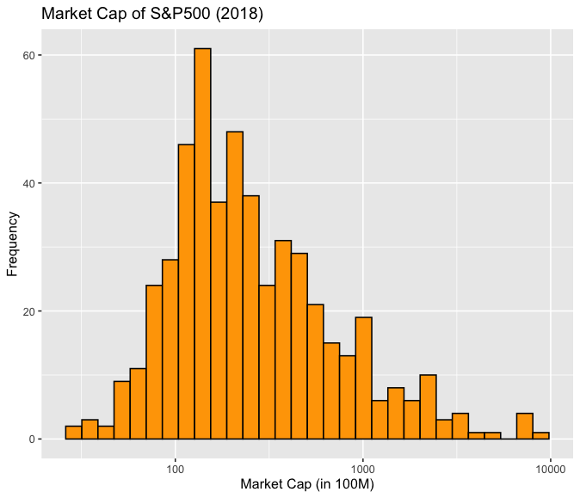
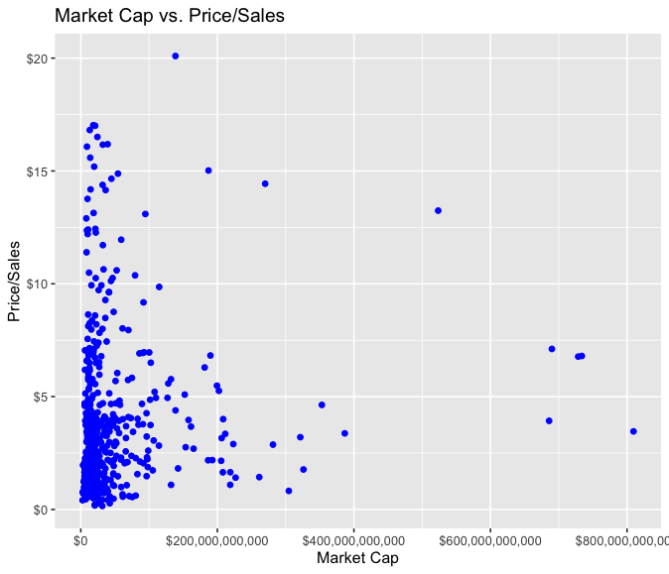
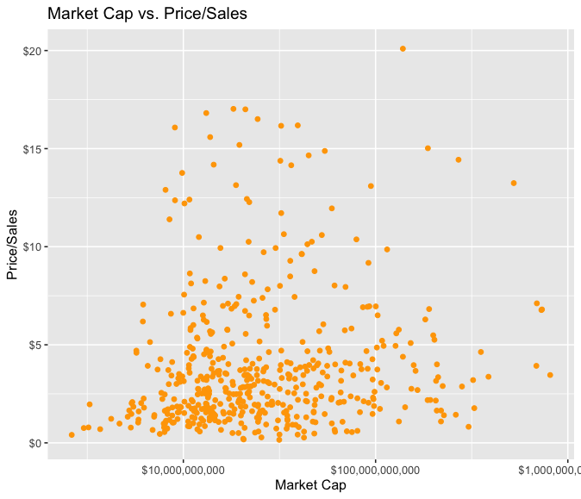
Skewed Data
Highly skewed data can be problematic in data science analysis
Especially with regression models (linear and logistic)
Can obscure patterns
Invalidates statistical tests
Consider Transformation
Log-scale
Square root
Binning

Slide 19

Missing Data
Missing Data: Data points that are not recorded or are absent in the dataset.
Can be represented by “.” “NA” “99” “-1” etc.
Python uses “NaN”
Reasons for missing data
data entry errors,
non-responses in surveys
system errors, etc.
Missing Data Considerations
How much is there?
Is it ”missing at random”
Is missing-ness important by itself?
How does the model handle it?
Pandas functions:
isnull(), notnull(): To detect missing values.

Slide 20
Strategies for Missing Data
Deletion Methods:
Row Deletion: Remove entire row if any value is NA.
Column Deletion: Delete features with high % of NA
These are drastic! Should evaluate impact on analysis
Imputation Methods:
Mean/Median/Mode Imputation:
Replace NAs with mean, median, or mode of the feature.
Modeled Imputation:
Use algorithms like regression or k-nearest neighbors to predict and fill missing values.
Interpolation
Give data point the average of the two observations surrounding it (why would you do this?)
Create a new category for NA
Pandas functions
dropna(): To drop rows or columns with missing values.
fillna(): To fill missing values with a specific value or method (mean, median, etc.)
SciKitLearn:
SimpleImputer: Basic imputation strategies
IterativeImputer: Modelling based imputation
Important to evaluate: How much influence does your strategy have on the final conclusions?
Notes:
Needs careful consideration
Robustness

Slide 21
Missing data : Considerations
Are there missing values in your target?
Are there specific rows with many missing values?
Is there a pattern to the missing values
Are they missing for the same observations
What percent of the overall cases are missing?
Is the ”missingness” important in itself?
Proceed with caution!
Some algorithms will remove the entire row if any feature is missing!

Slide 22
Data Visualization

Slide 23
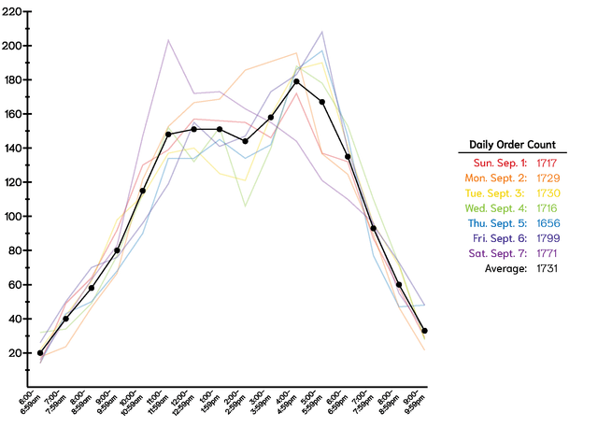
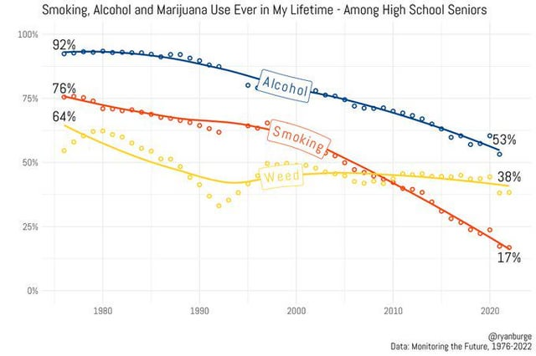
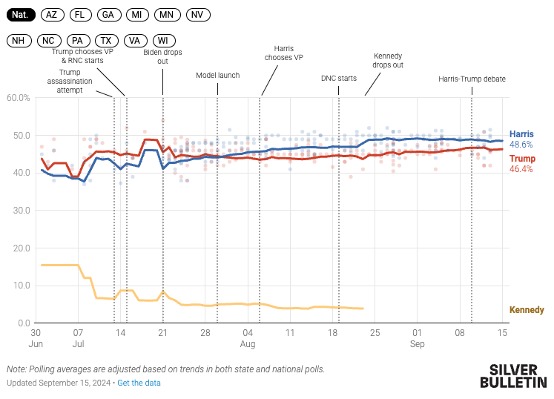
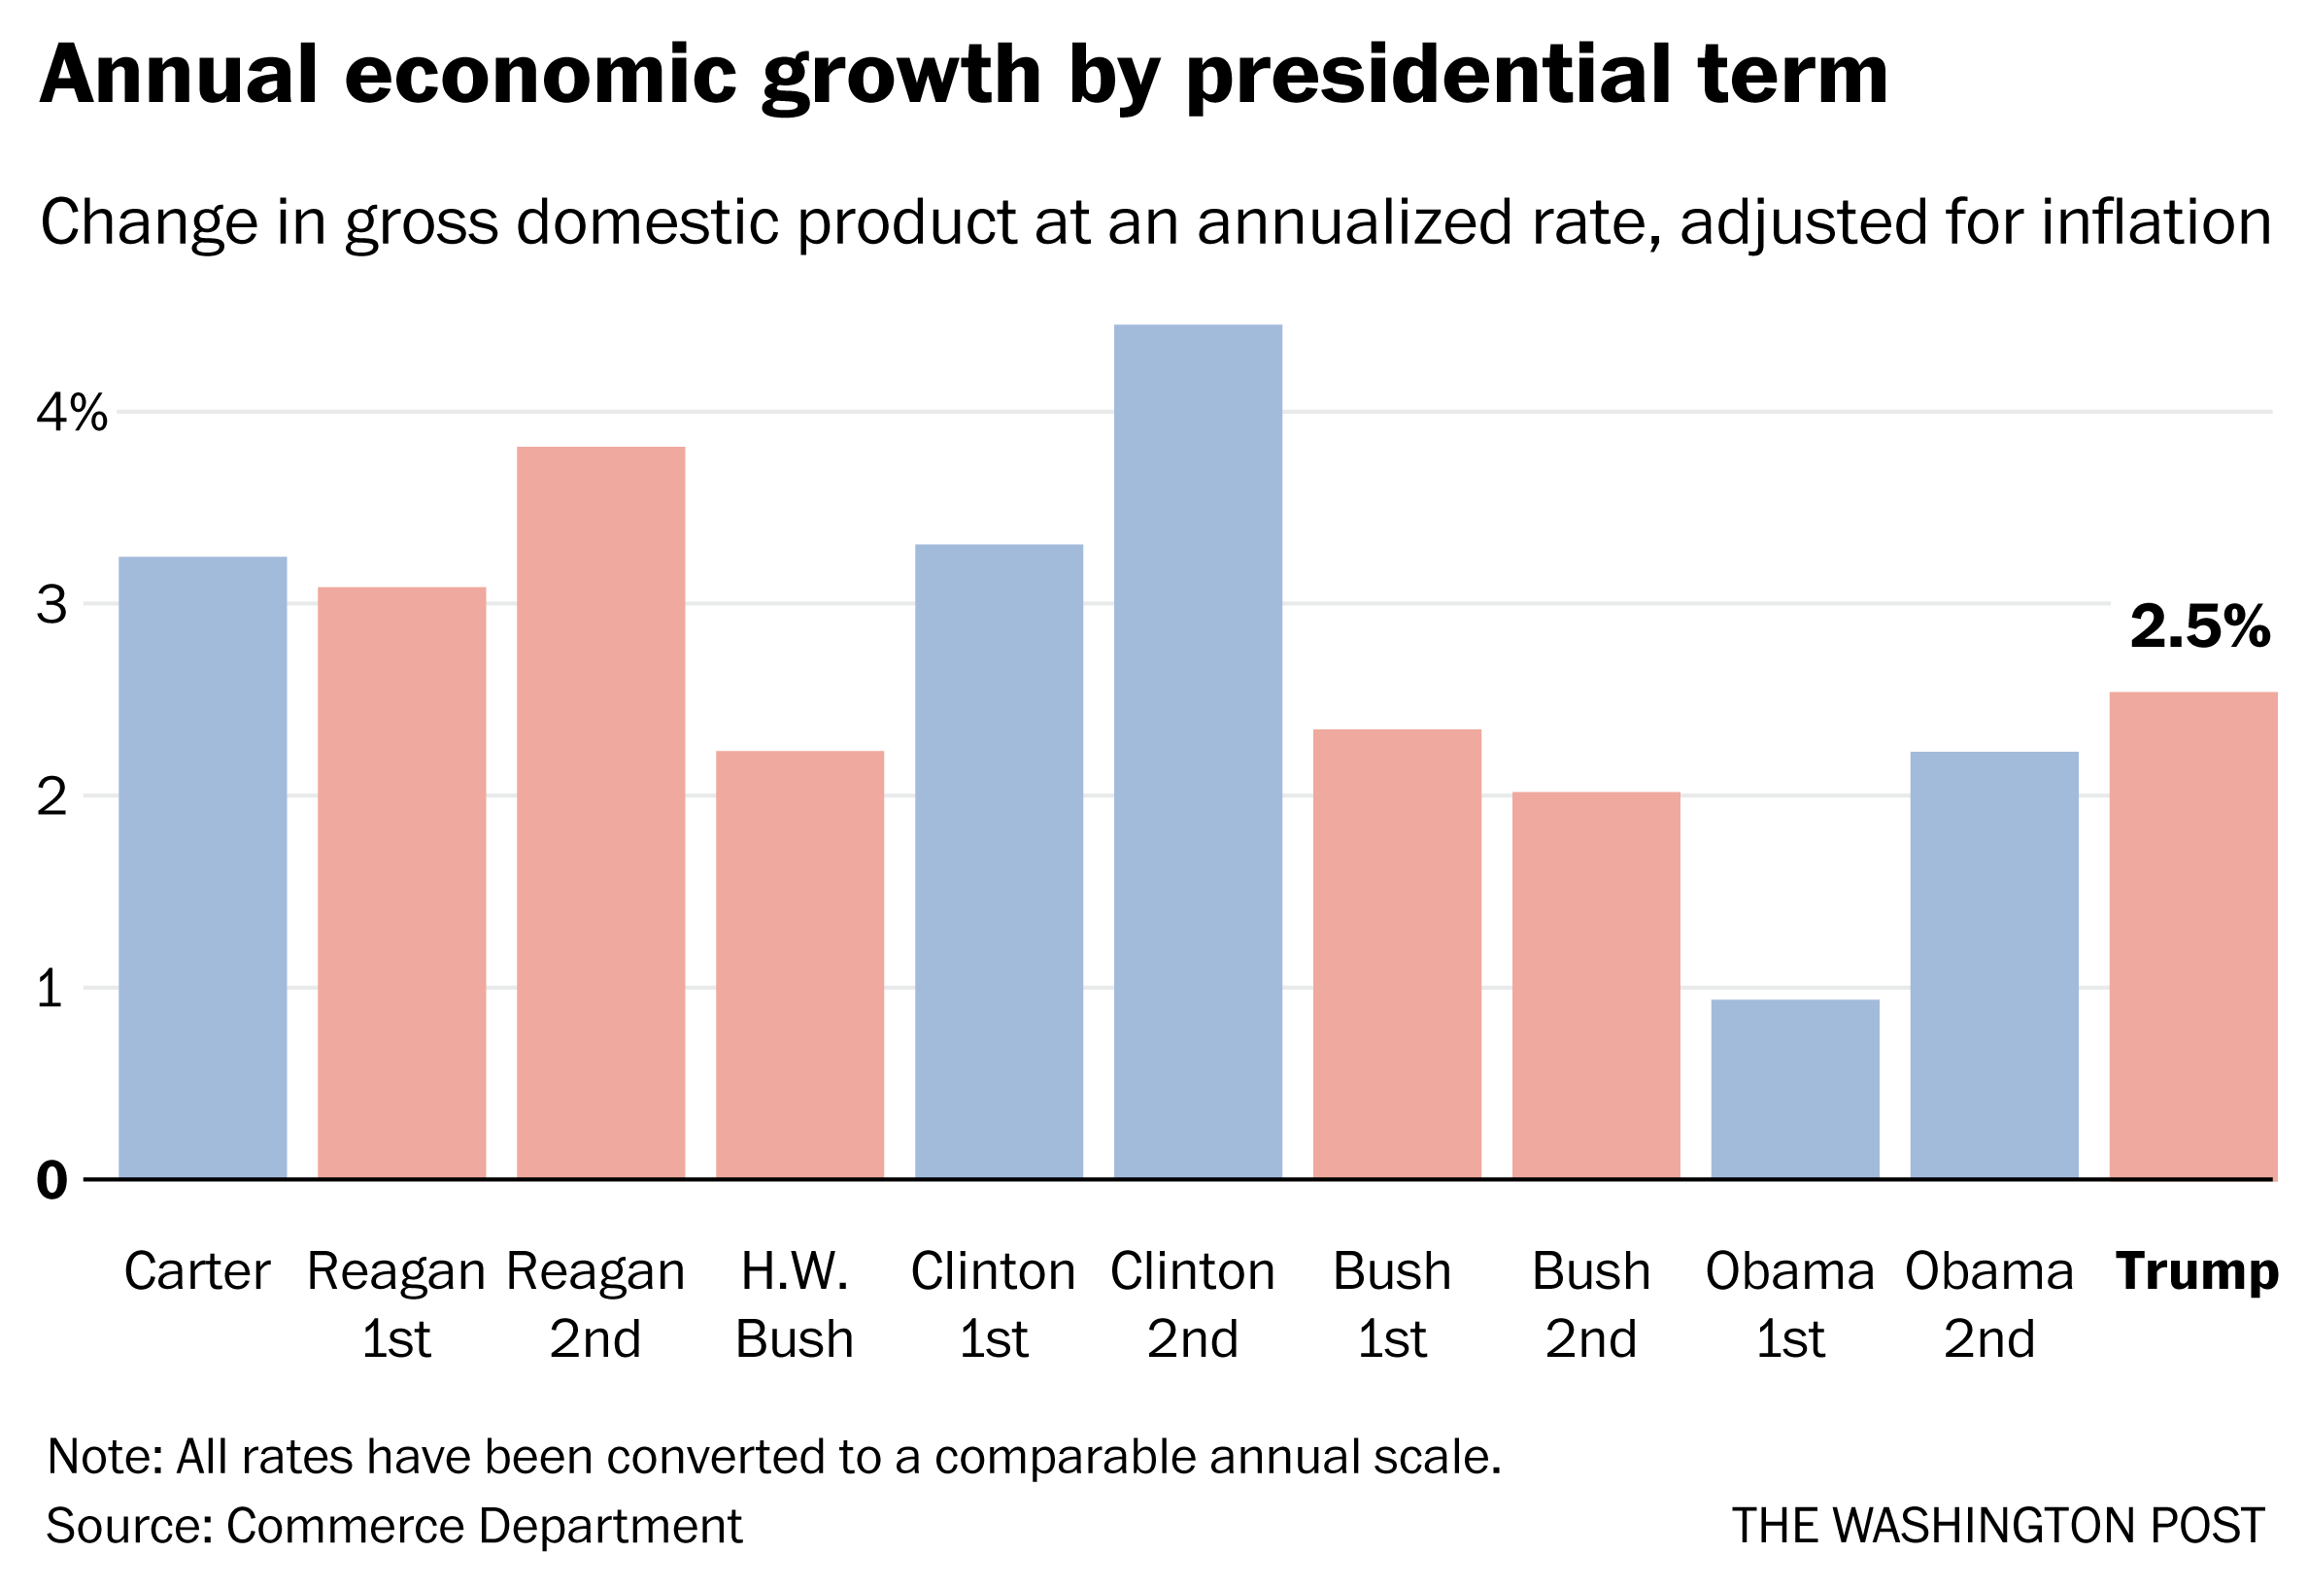
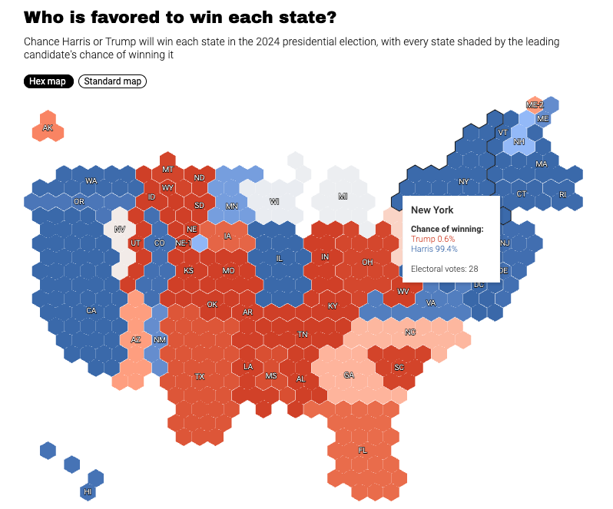
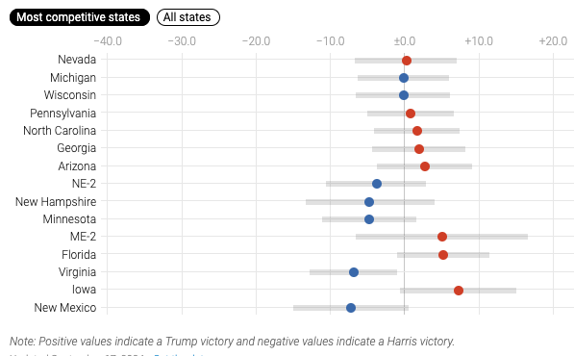
Effective visualizations say a lot with a little:
https://www.reddit.com/r/dataisbeautiful/

Slide 24
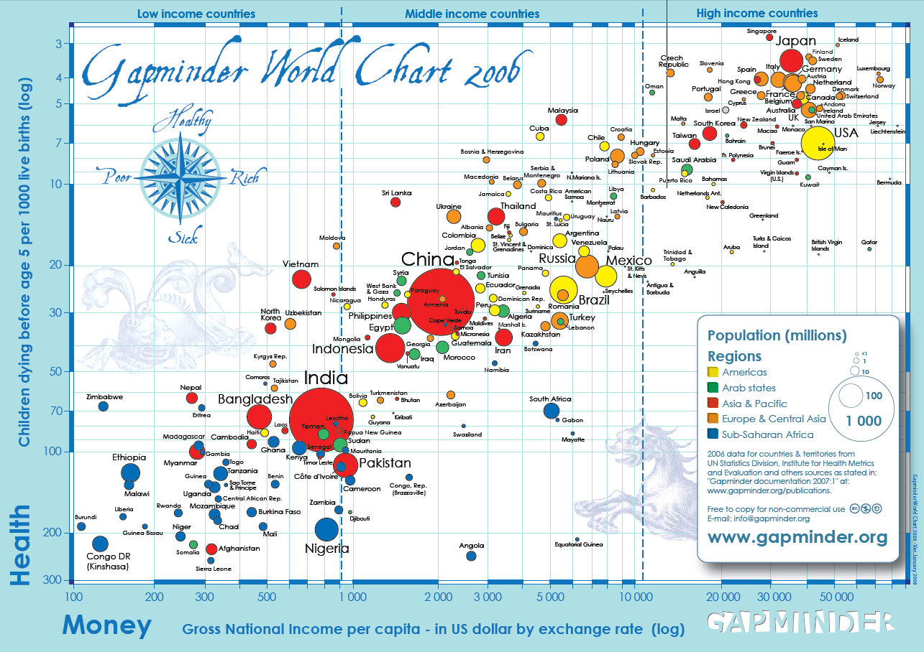

Data Viz: Good examples
The best data visualization talk you will ever see:
Hans Rosling
https://www.youtube.com/watch?v=usdJgEwMinM

Slide 25
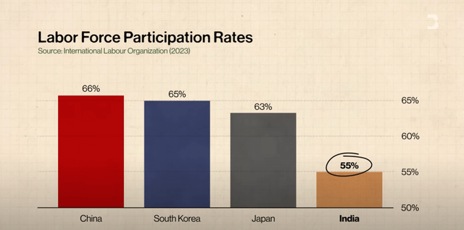
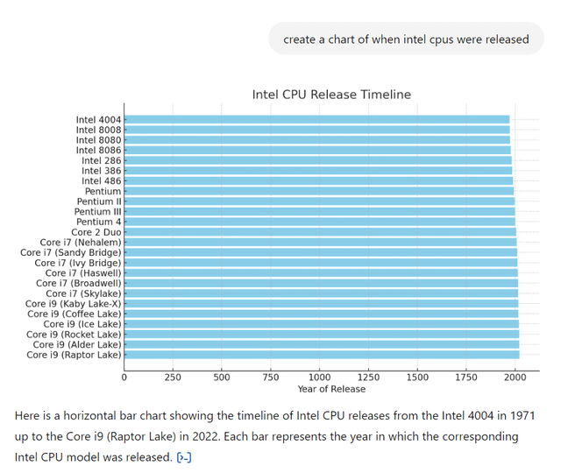
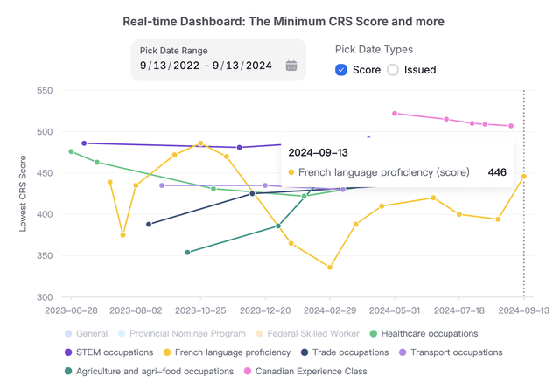
Data Viz: Bad Examples
Purposely bad
Bad design
Made by AI!
https://www.reddit.com/r/dataisugly/

Slide 26
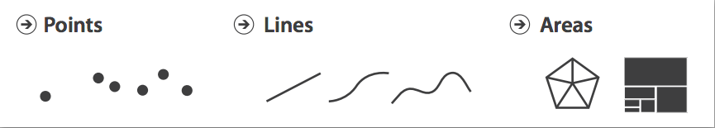
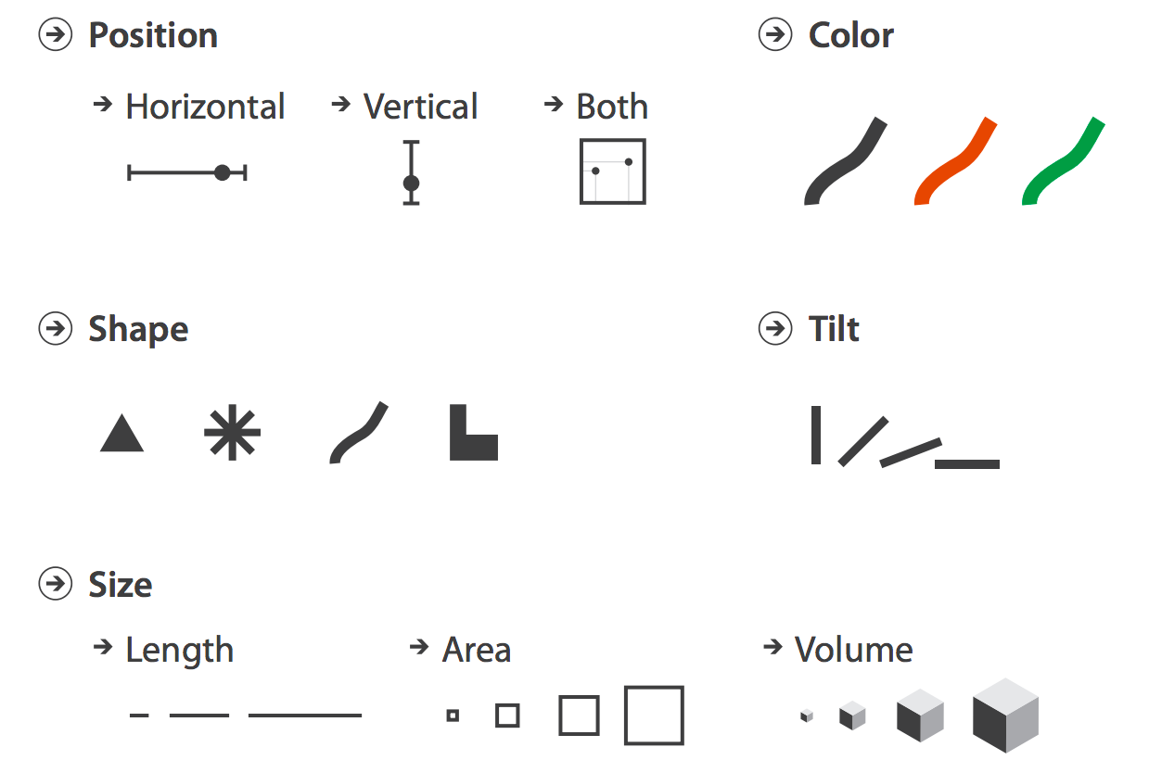
Data Visualization
Data Visualization is a challenging topic – very hard to do well
Many design decisions to make
INFO-GB 3306.10
Data Visualization theory covers things like
What do humans perceive well
How to use marks, color, etc.
Basic components of data visualization can be used effectively as part of the EDA process
Histograms
Boxplots
Scatterplots

Slide 27
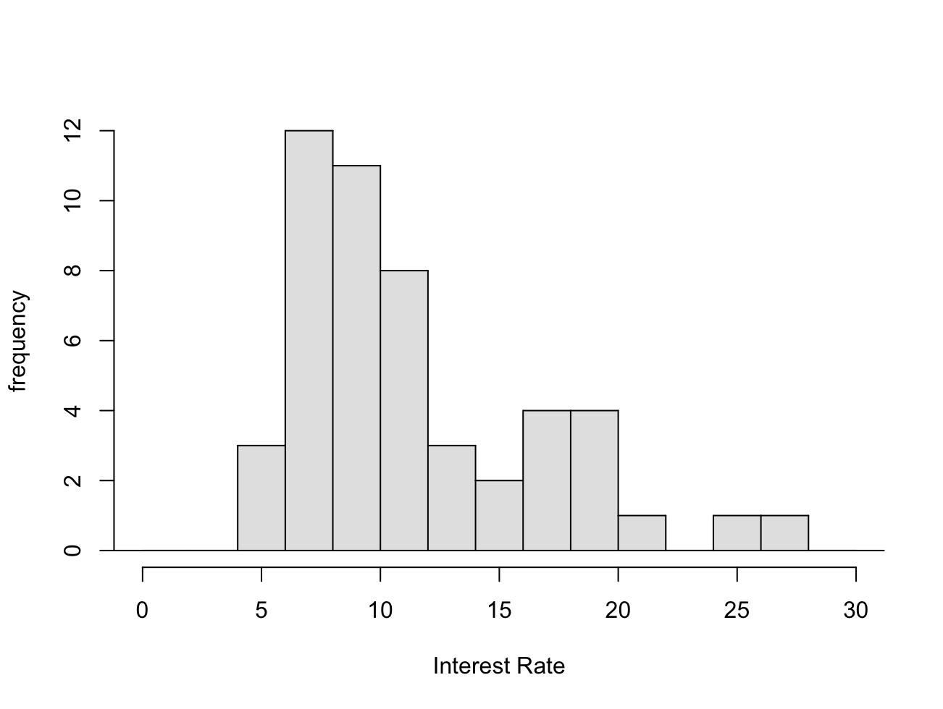
Visualizing Numeric Data: Histograms
Probably most used (and useful) way to present numeric data
Histograms provide a view of the data density. Higher bars represent where the data are relatively more common.
Histograms are especially convenient for describing the shape of the data distribution.
What do you learn from this?
https://www.openintro.org/data/index.php?data=loan50
Notes:
Maybe go back to echo.csv data…

Slide 28
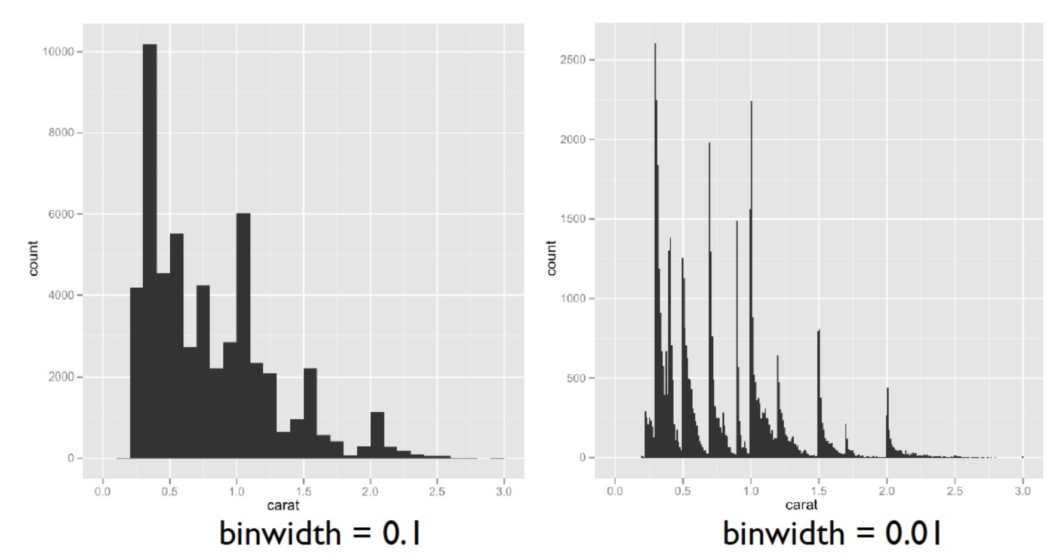
Histograms: Bin Width

Slide 29
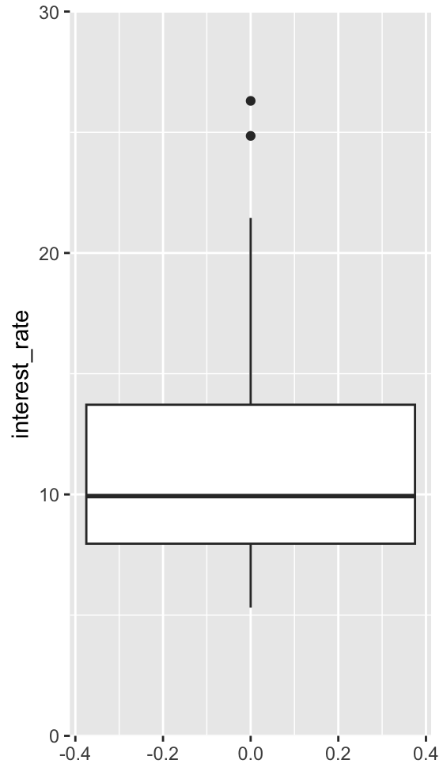
Boxplots
A Boxplot is another way of getting a quick visual clue of the key points of the data distribution:
Suspected “Outliers”
Upper range
75th percentile
median
25th percentile
Lower range
Notes:
Remember not to be too harsh on outliers.

Slide 30
Boxplots
Outliers are called out in boxplots for further evaluation
Suspected Outliers
1.5 x Interquartile Range (IQR*)
IQR=75th%ile - 25th%ile
Any point further than 1.5 x IQR away from the box is labelled a potential outlier
Warning: software may differ on this definition

Slide 31
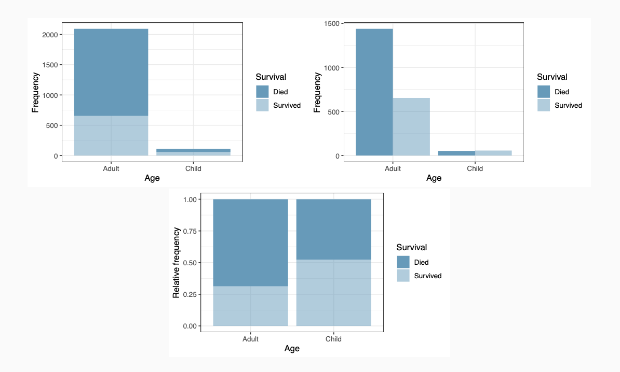
Multiple Variables: Categorical
Three different ways of presenting contingency tables
Stacked bar
Side-by-side bar
Kaggle Titanic Data
Standardized bar

Slide 32
Visualizations
Many design decisions go into data visualization
Takes careful thought as to the message you are trying to convey
Example Data : Customer Purchase data (n=200)
> cseg_df
| Index | CustomerID | Age Group | Product Category | Purchase Frequency |
|--------:|-------------:|:------------|:-------------------|:---------------------|
| 1 | 674852 | 26-35 | Home & Kitchen | Low |
| 2 | 900795 | 60+ | Electronics | High |
| 3 | 107026 | 46-60 | Electronics | Medium |
| 4 | 336542 | 36-45 | Sports & Outdoors | High |
| 5 | 871414 | 18-25 | Home & Kitchen | Low |
| 6 | 519718 | 18-25 | Clothing | High |
| 7 | 373993 | 18-25 | Electronics | Low |
| 8 | 819752 | 46-60 | Home & Kitchen | Low |
| 9 | 668056 | 36-45 | Electronics | High |
| 10 | 621755 | 46-60 | Books | Low |
Notes:
Ask questions:
What kind of data do we have here?
What do we want to visualize (counts!)
Which columns do we use?

Slide 33
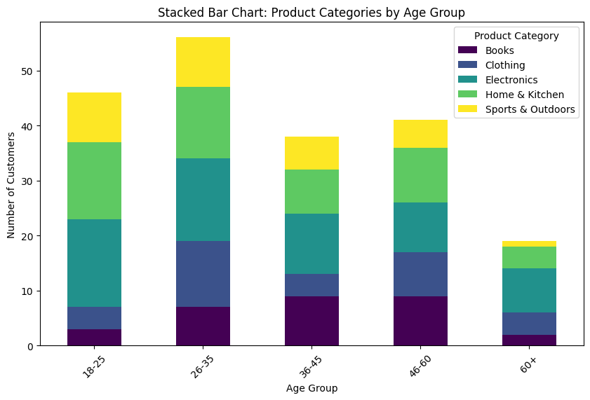
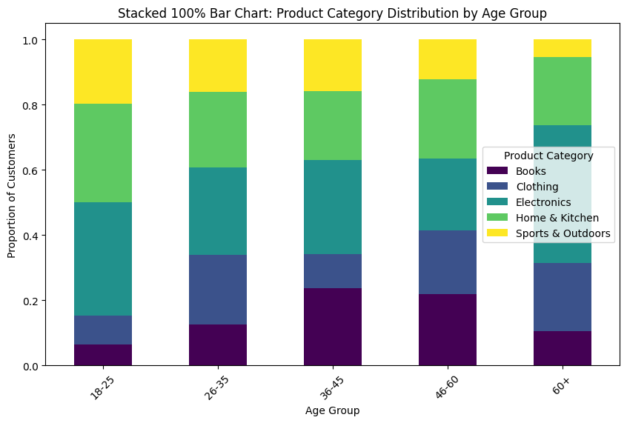
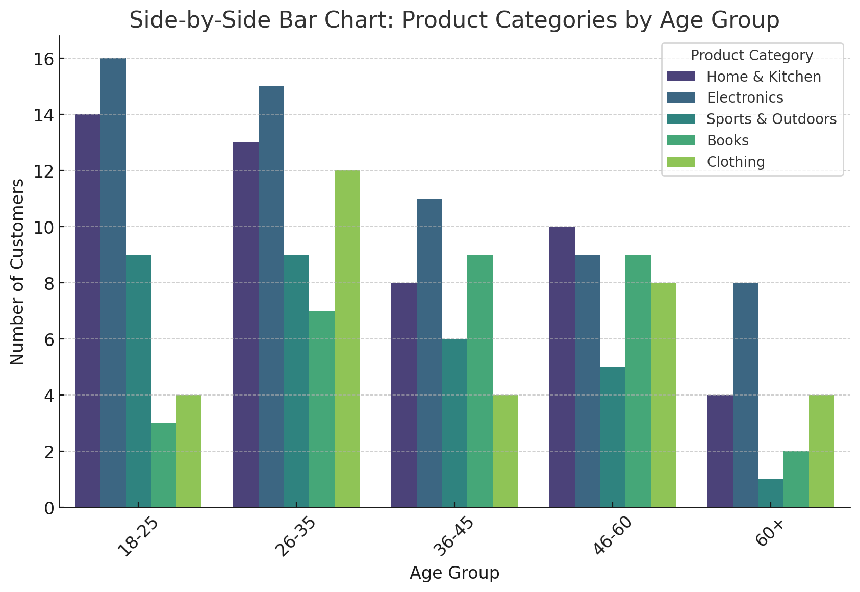

Slide 34
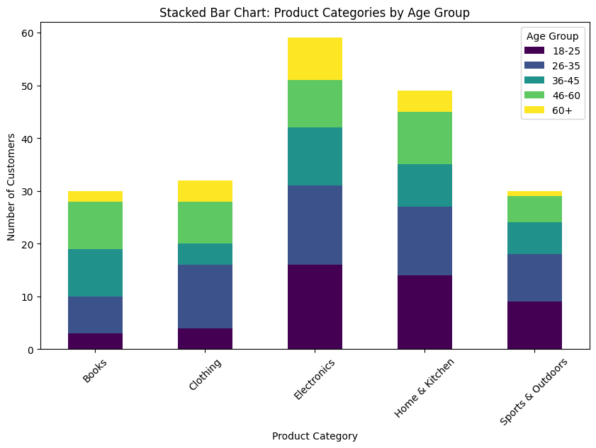
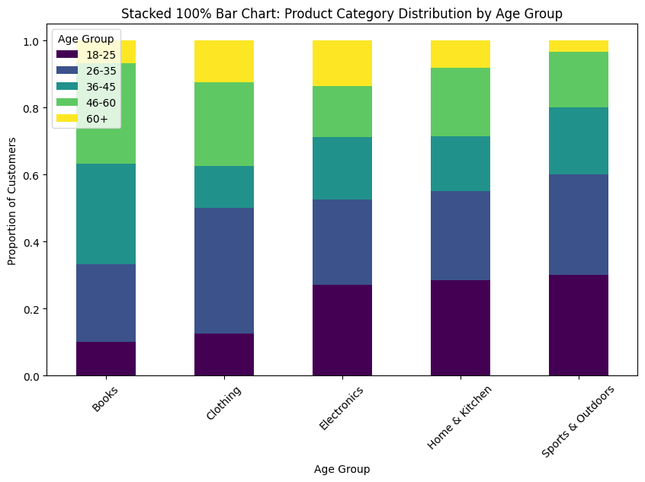
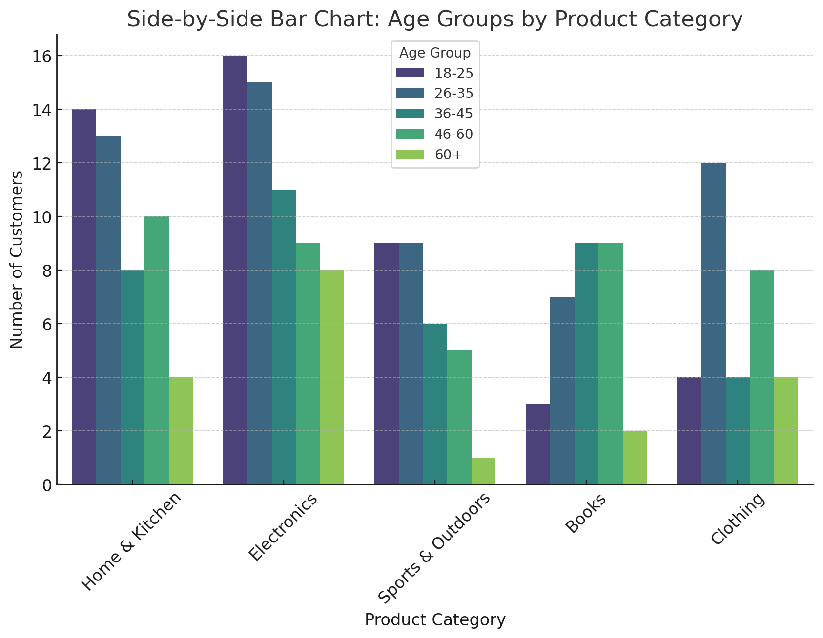

Slide 35
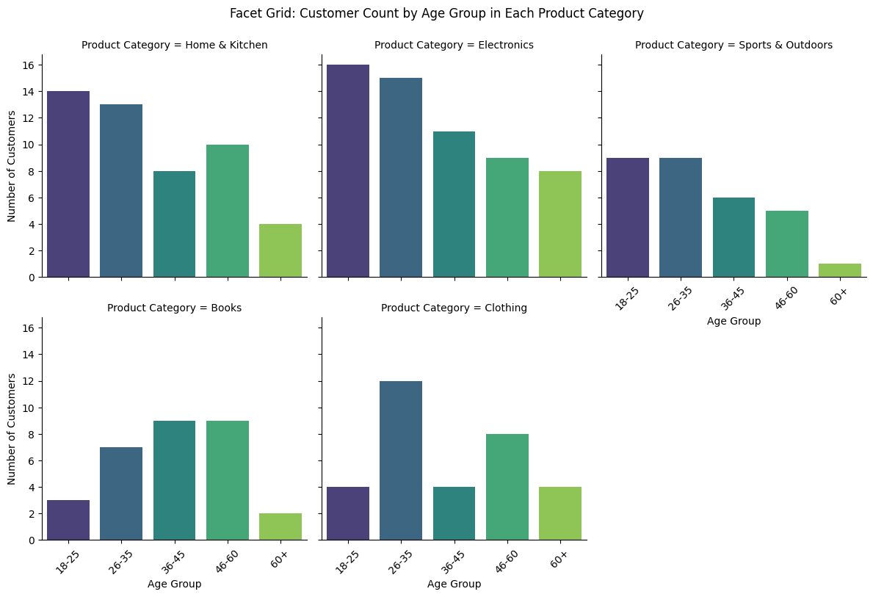

Slide 36
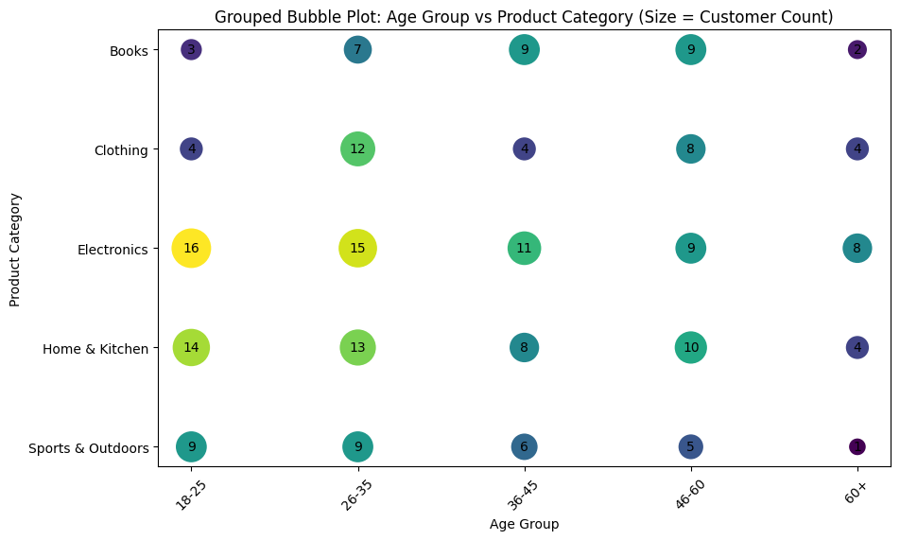
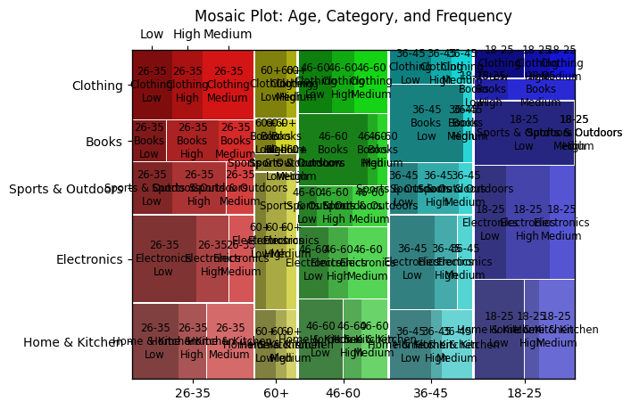
Notes:
Bubble might be useful

Slide 37
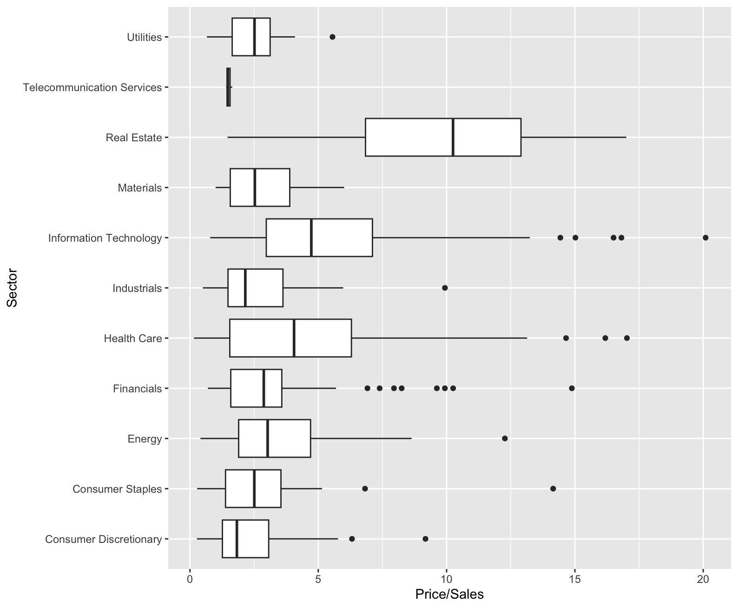
Mulitple Variables: Categorical and Numeric
Side by side boxplots allow you to compare numeric distributions across variables which are categorical
S&P 500 data
Price/Sales ratio
by Sector

Slide 38
Multiple Numeric Variables- Scatterplot
Scatterplot is the standard tool to display relation between 2 variables
e.g. y-axis = response, x-axis = suspected indicator
useful to answer:
x,y related?
Linear correlation
quadratic
Other
Strange patterns?
outliers present?
Use “alpha blending” for overplotting

Slide 39
Python Visualizations
T3_DataViz.ipynb

Slide 40
From Exploration to Model Fitting
Fitting data science models all follow the same basic structure
Instantiate model
Set model parameters
Identify X (predictors) and Y (target)
Create training/test sets
Use .fit to apply model to data
Set other parameters
Explore outcome of model
Sometimes model dependent
Calculate model fit metrics
Do this over and over again!
my_regression = LinearRegression()
X_train, X_test, y_train, y_test = train_test_split(X, y, test_size=0.2)
my_regression.fit(X_train, y_train)
y_pred = my_regression.predict(X_test)
rmse = mean_squared_error(y_test, y_pred, squared=False)

Slide 41
Class Exercise: Fitting Data Science Models
T3_Fitting_Data_Science_Models.ipynb

